Slide 1
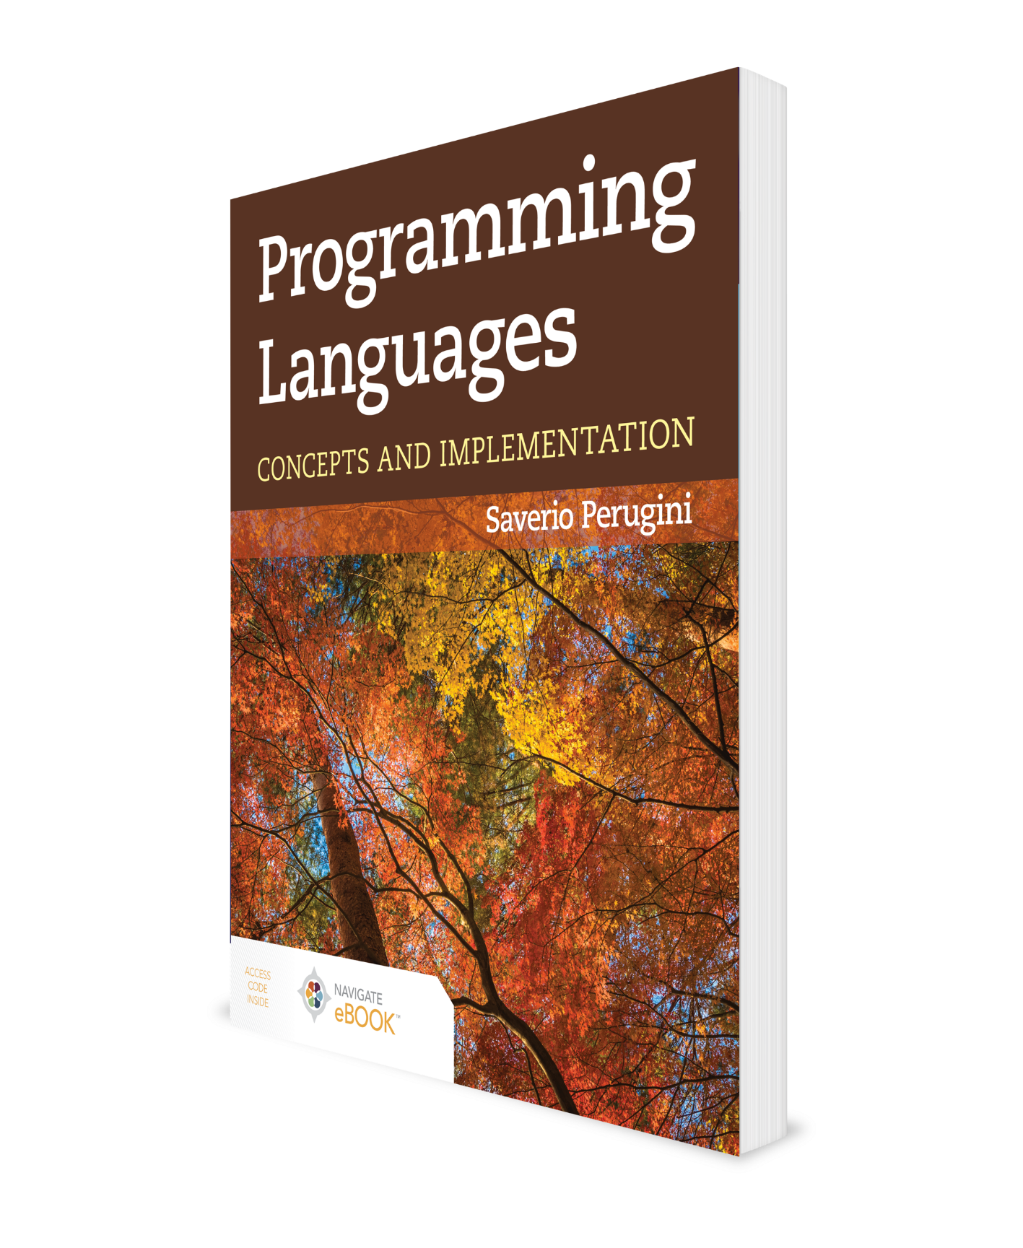
Type Systems
CHAPTER 7

Slide 2
Chapter 7: Type Systems
Clumsy type systems drive people to dynamically typed languages.
—Robert Griesemer
We study programming language concepts related to types—particularly, type systems and type inference—in this chapter.

Slide 3
Outline
7.1 Chapter Objectives
7.2 Introduction
7.3 Type Checking
7.4 Type Conversion, Coercion, and Casting
7.5 Parametric Polymorphism
7.6 Operator/Function Overloading
7.7 Function Overriding
7.8 Static/Dynamic Typing Vis-à-Vis Explicit/Implicit Typing
7.9 Type Inference
7.10 Variable-Length Argument Lists in Scheme
7.11 Thematic Takeaways

Slide 4
7.1 Chapter Objectives
Compare the two varieties of type systems for type checking in programming languages: statically typed and dynamically typed.
Describe type conversions (e.g., type coercion and type casting), parametric polymorphism, and type inference.
Differentiate between parametric polymorphism and function overloading.
Differentiate between function overloading and function overriding.

Slide 5
Outline
7.1 Chapter Objectives
7.2 Introduction
7.3 Type Checking
7.4 Type Conversion, Coercion, and Casting
7.5 Parametric Polymorphism
7.6 Operator/Function Overloading
7.7 Function Overriding
7.8 Static/Dynamic Typing Vis-à-Vis Explicit/Implicit Typing
7.9 Type Inference
7.10 Variable-Length Argument Lists in Scheme
7.11 Thematic Takeaways

Slide 6
7.2 Introduction (1 of 2)
The type system in a programming language broadly refers to the language’s approach to type checking.
In a static type system, types are checked and almost all type errors are detected before run-time.
In a dynamic type system, types are checked and most type errors are detected at run-time.
Languages with static type systems are said to be statically typed or to use static typing.
Languages with dynamic type systems are said to be dynamically typed or to use dynamic typing.
Reliability, predictability, safety, and ease of debugging are advantages of a statically typed language.
Flexibility and efficiency are benefits of using a dynamically typed language.

Slide 7
7.2 Introduction (2 of 2)
There are a variety of methods for achieving a degree of flexibility within the confines of the type safety afforded by some statically typed languages:
  parametric polymorphism,
  ad hoc polymorphism, and
  type inference.
Why ML and Haskell?

Slide 8
Outline
7.1 Chapter Objectives
7.2 Introduction
7.3 Type Checking
7.4 Type Conversion, Coercion, and Casting
7.5 Parametric Polymorphism
7.6 Operator/Function Overloading
7.7 Function Overriding
7.8 Static/Dynamic Typing Vis-à-Vis Explicit/Implicit Typing
7.9 Type Inference
7.10 Variable-Length Argument Lists in Scheme
7.11 Thematic Takeaways

Slide 9
7.3 Type Checking
A type is a set of values (e.g., int in C = {-2¹⁵ .. 2¹⁵ - 1}) and the permissible operations on those values (e.g., + and *).
Type checking verifies that the values of types and (new) operations on them—and the values they return—abide by these constraints.
Languages that permit programmers to deliberately violate the integrity constraints of types (e.g., by granting them access to low-level machine primitives and operations) have unsound or unsafe type systems.
  e.g., Fortran, C, and C++ are weakly typed languages.
In contrast, other languages do not permit programmers to circumvent type constraints
  e.g., Java, ML, and Haskell all have a sound or safe type system and are, thus, sometimes referred to as strongly typed or type safe languages (Table 7.1).

Slide 10
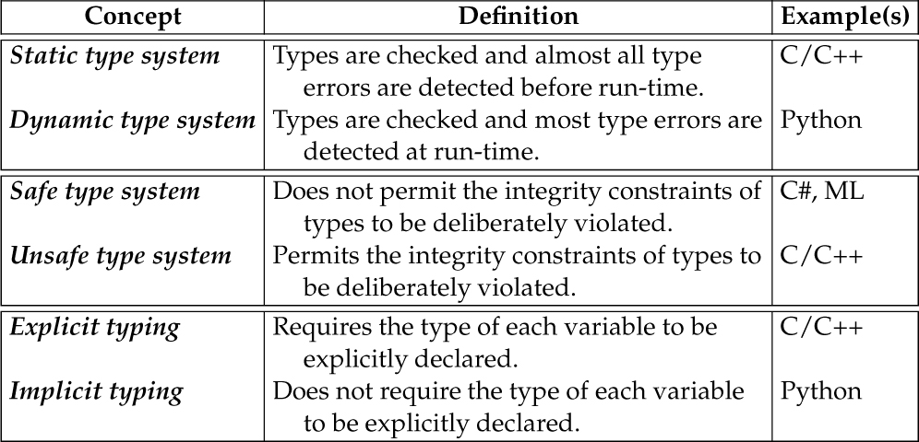
Table 7.1 Features of Type Systems Used in Programming Languages

Slide 11
Outline
7.1 Chapter Objectives
7.2 Introduction
7.3 Type Checking
7.4 Type Conversion, Coercion, and Casting
7.5 Parametric Polymorphism
7.6 Operator/Function Overloading
7.7 Function Overriding
7.8 Static/Dynamic Typing Vis-à-Vis Explicit/Implicit Typing
7.9 Type Inference
7.10 Variable-Length Argument Lists in Scheme
7.11 Thematic Takeaways

Slide 12
7.4 Type Conversion, Coercion, and Casting (1 of 2)
7.4.1 Type Coercion: Implicit Conversion
7.4.2 Type Casting: Explicit Conversion
7.4.3 Type Conversion Functions: Explicit Conversion

Slide 13
7.4 Type Conversion, Coercion, and Casting (2 of 2)
There are a variety of methods for providing programmers with a degree of flexibility within the confines of the type safety afforded by some statically typed languages, thereby mitigating the rigidity enforced by a sound type system.
These methods include conversions of various sorts, parametric and ad hoc polymorphism, and type inference.

Slide 14
7.4.1 Type Coercion: Implicit Conversion
Coercion is an implicit conversion in which values can deviate from the type required by an operator or function without warning or error because the appropriate conversions are made automatically before or at run-time and are transparent to the programmer.
See the C program coercion.c
Notice also that coercion happens automatically without any intervention from the programmer.
See the C program storage.c
There are no guarantees with coercion.
Java does not perform coercion (see NoCoercion.java), even between floats and doubles (see NoCoercion2.java)

Slide 15
7.4.2 Type Casting: Explicit Conversion
There are two forms of explicit type conversions:
  type casts and
  conversion functions.
A type cast is an explicit conversion that entails interpreting the bit pattern used to represent a value of a particular type as another type.
See the C program cast.c.

Slide 16
7.4.3 Type Conversion Functions: Explicit Conversion
Some languages also support built-in or library functions to convert values from one data type to another.
See the C program conversion.c.
Since the statically typed language ML does not have coercion, it needs provisions for converting values between types.
ML supports conversions of values between types through functions.
Conversion functions are necessary in Haskell, even though types can be mixed in some Haskell expressions.

Slide 17
Outline
7.1 Chapter Objectives
7.2 Introduction
7.3 Type Checking
7.4 Type Conversion, Coercion, and Casting
7.5 Parametric Polymorphism
7.6 Operator/Function Overloading
7.7 Function Overriding
7.8 Static/Dynamic Typing Vis-à-Vis Explicit/Implicit Typing
7.9 Type Inference
7.10 Variable-Length Argument Lists in Scheme
7.11 Thematic Takeaways

Slide 18
7.5 Parametric Polymorphism:
Monomorphic Function Types
Both ML and Haskell assign a unique type to every value, expression, operator, and function.
Recall that the type of an operator or function describes the types of its domain and range.
Certain operators require values of a particular type.
  e.g., the div (i.e., division) operator in ML requires two operands of type int and has type ,
  whereas the / (i.e., division) operator in ML requires two operands of type real and has type .
These operators are monomorphic, meaning they have only one type.

Slide 19
7.5 Parametric Polymorphism:
Polymorphic Function Types (1 of 3)
Other operators or functions are polymorphic, meaning they can accept arguments of different types.
  For example, the type of the (+) (i.e., prefix addition) operator in Haskell is
indicating that if type a is in the type class Num, then the + operator has type
In other words, (+) is an operator that maps two values of the same type a to a value of the same type a.
If the first operand to the (+) operator is of type Int, then (+) is an operator that maps two Ints to an Int.

Slide 20
7.5 Parametric Polymorphism:
Polymorphic Function Types (2 of 3)
With this type of polymorphism, referred to as parametric polymorphism, a function or data type can be defined generically so that it can handle arguments in an identical manner, no matter what their type.
The types themselves in the type signature are parameterized.

Slide 21
7.5 Parametric Polymorphism:
Polymorphic Function Types (3 of 3)
A polymorphic function type in ML or Haskell specifies that the type of any function with that polymorphic type is one of multiple monomorphic types.
Recall that a polymorphic function type is a type expression containing type variables.
The polymorphic type in Haskell is a shorthand for a collection of the following (non-exhaustive) list of types:
, , ,
and so on.
Unlike in languages with unsafe type systems (e.g., C or C++), in ML, the programmer is not permitted—because a program doing so will not run—to deviate at all from the required types when invoking an operator or function.

Slide 22
7.5 Parametric Polymorphism
In Haskell, as in ML, the programmer is not permitted to deviate at all from the required types when invoking an operator or function.
However, unlike ML, Haskell has a hierarchy of type classes, where a class is a collection of types, which provides flexibility in function definition and application.
Haskell’s type class system comprises a hierarchy of interoperable type, where a value of a type (e.g., Integral) is also considered a value of one of the supertypes of that type in the hierarchy (e.g., Num).

Slide 23


Contrast a square Function in Haskell with That in ML
Haskell
ML
In Haskell, the type of square is called a qualified type and Num is a type class.

Slide 24

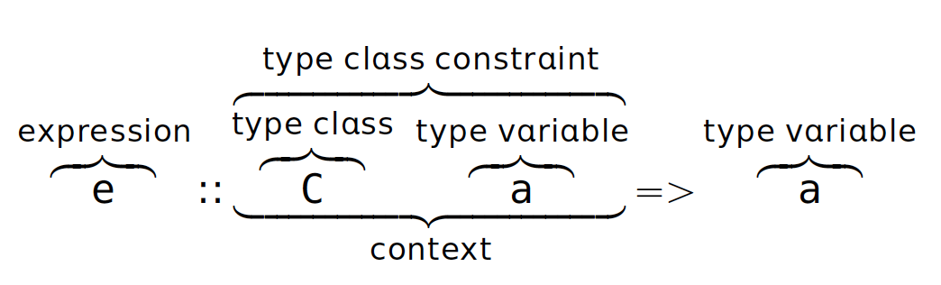
Qualified or Constrained Types in Haskell
The fromInteger function is implicitly (i.e., automatically and transparently to the programmer) applied to every literal number without a decimal point:
This response indicates that if type p is in the type class Num, then 1 has the type p.
In other words, 1 is of some type in the Num class.
Such a type is called a qualified type or constrained type (Table 7.2).
A type class is a collection of types that are guaranteed to have definitions for a set of functions—like a Java interface.

Slide 25
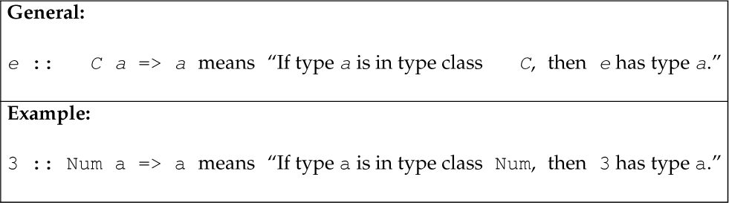
Table 7.2 The General Form of a Qualified Type or Constrained Type and an Example

Slide 26
Outline
7.1 Chapter Objectives
7.2 Introduction
7.3 Type Checking
7.4 Type Conversion, Coercion, and Casting
7.5 Parametric Polymorphism
7.6 Operator/Function Overloading
7.7 Function Overriding
7.8 Static/Dynamic Typing Vis-à-Vis Explicit/Implicit Typing
7.9 Type Inference
7.10 Variable-Length Argument Lists in Scheme
7.11 Thematic Takeaways

Slide 27
7.6 Operator/Function Overloading (1 of 3)
Operator/function overloading refers to using the same function name for multiple function definitions, where the type signature of each definition involves
  a different return type,
  different types of parameters,
  and/or a different number of parameters.
When an overloaded function is invoked, the applicable function definition to bind to the function call (obtained from a collection of definitions with the same name) is determined based on
  the number and/or
  the types of arguments used in the invocation.
Function/operator overloading is also called ad hoc polymorphism.

Slide 28
7.6 Operator/Function Overloading (2 of 3)
See overloading.hs
In C, functions cannot be overloaded (see nooverloading.c)
ML, Haskell, and C do not support function overloading.
C++ and Java do support function overloading:
See overloading.cpp, overloading2.cpp, and Overloading.java

Slide 29
7.6 Operator/Function Overloading (3 of 3)
The Haskell type class system supports the definition of what seem to be overloaded functions like square.
The flexibility fostered by a type or class hierarchy in the definition of functions is similar to ad hoc polymorphism (i.e., overloading), but is called interface polymorphism.
ML and Haskell programs are thoroughly type-checked before run-time.
Almost no ML or Haskell program that can run will ever have a type error.

Slide 30
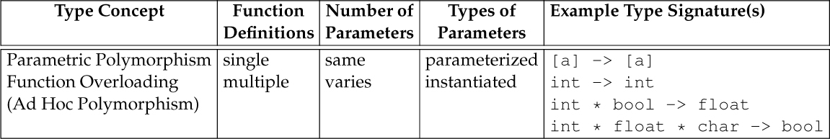
Table 7.3 Parametric Polymorphism Vis-à-Vis Function Overloading

Slide 31
Outline
7.1 Chapter Objectives
7.2 Introduction
7.3 Type Checking
7.4 Type Conversion, Coercion, and Casting
7.5 Parametric Polymorphism
7.6 Operator/Function Overloading
7.7 Function Overriding
7.8 Static/Dynamic Typing Vis-à-Vis Explicit/Implicit Typing
7.9 Type Inference
7.10 Variable-Length Argument Lists in Scheme
7.11 Thematic Takeaways

Slide 32
7.7 Function Overriding (1 of 3)
Function overriding (also called function hiding) occurs when multiple function definitions share the same function name, but only one of those function definitions is visible at any point in the program due to the presence of scope holes.

Slide 33
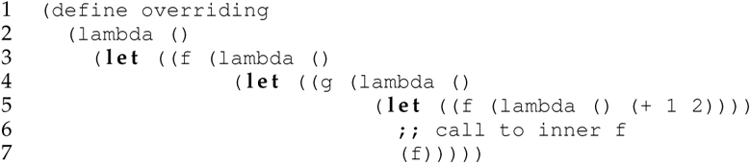

7.7 Function Overriding (2 of 3)

Slide 34
7.7 Function Overriding (3 of 3)
Here, the call to function f on line 10 binds to the outermost definition of f (starting on line 3) because the innermost definition of f (line 5) is not visible on line 10—it is defined in a nested block.
The call to function f on line 7 binds to the innermost definition of f (line 5) because on line 7 where f is called, the innermost definition of f (line 5) shadows the outermost definition of f.
In other words, the outermost definition of f is not visible on line 7.

Slide 35
Outline
7.1 Chapter Objectives
7.2 Introduction
7.3 Type Checking
7.4 Type Conversion, Coercion, and Casting
7.5 Parametric Polymorphism
7.6 Operator/Function Overloading
7.7 Function Overriding
7.8 Static/Dynamic Typing Vis-à-Vis Explicit/Implicit Typing
7.9 Type Inference
7.10 Variable-Length Argument Lists in Scheme
7.11 Thematic Takeaways

Slide 36
7.8 Static/Dynamic Typing Vis-à-Vis Explicit/Implicit Typing
The concepts of static/dynamic typing and explicit/implicit typing are sometimes confused and used interchangeably.
The modifiers “static” or “dynamic” on “typing” (or “checking”) indicate the time at which types and type errors are checked.
However, the types of those variables can be declared explicitly (e.g., int x = 1; in Java) or implicitly (e.g., x = 1 in Python).
Languages that require the type of each variable to be explicitly declared use explicit typing.
Languages that do not require the type of each variable to be explicitly declared use implicit typing, which is also referred to as manifest typing (Table 7.1).
Statically typed languages can use either explicit (e.g., Java) or implicit (e.g., ML and Haskell) typing.
Dynamically typed languages typically use implicit typing (e.g., Python, JavaScript, Ruby).

Slide 37
Outline
7.1 Chapter Objectives
7.2 Introduction
7.3 Type Checking
7.4 Type Conversion, Coercion, and Casting
7.5 Parametric Polymorphism
7.6 Operator/Function Overloading
7.7 Function Overriding
7.8 Static/Dynamic Typing Vis-à-Vis Explicit/Implicit Typing
7.9 Type Inference
7.10 Variable-Length Argument Lists in Scheme
7.11 Thematic Takeaways

Slide 38
7.9 Type Inference (1 of 3)
Explicit type declarations of values and variables help inform a static type system.
See also declaring.hs
In some languages with first-class functions, especially statically typed languages, functions have types.
Instead of ascribing a type to each individual parameter and the return type of a function, we can declare the type of the entire function.
Explicitly declaring types requires effort on the part of the programmer and can be perceived as requiring more effort than necessary to justify the benefits of a static type system.

Slide 39
7.9 Type Inference (2 of 3)
Type inference is a concept of programming languages that represents a compromise and attempts to provide the best of both worlds.
Type inference refers to the automatic deduction of the type of a value or variable without an explicit type declaration.
ML and Haskell use type inference, so the programmer is not required to declare the type of any variable.
ML and Haskell include a built-in type inference engine (i.e., Hindley–Milner algorithm) to deduce the type of a value based on context.

Slide 40
7.9 Type Inference (3 of 3)
Strong typing provides safety, but requires a type to be associated with every name.
The use of type inference in a statically typed language obviates the need to associate a type with each identifier:

Slide 41
Outline
7.1 Chapter Objectives
7.2 Introduction
7.3 Type Checking
7.4 Type Conversion, Coercion, and Casting
7.5 Parametric Polymorphism
7.6 Operator/Function Overloading
7.7 Function Overriding
7.8 Static/Dynamic Typing Vis-à-Vis Explicit/Implicit Typing
7.9 Type Inference
7.10 Variable-Length Argument Lists in Scheme
7.11 Thematic Takeaways

Slide 42
7.10 Variable-Length Argument Lists in Scheme (1 of 2)
Every function in Scheme is defined to accept only one list argument.
Arguments to any Scheme function are always received collectively as one list, not as individual arguments.
It is up to the programmer to decompose that argument list and group individual arguments in the formal parameter specification of the function definition using dot notation.
Moreover, Scheme, like ML and Haskell, does pattern matching from this single list of arguments to the specification of the parameter list in the function definition.

Slide 43
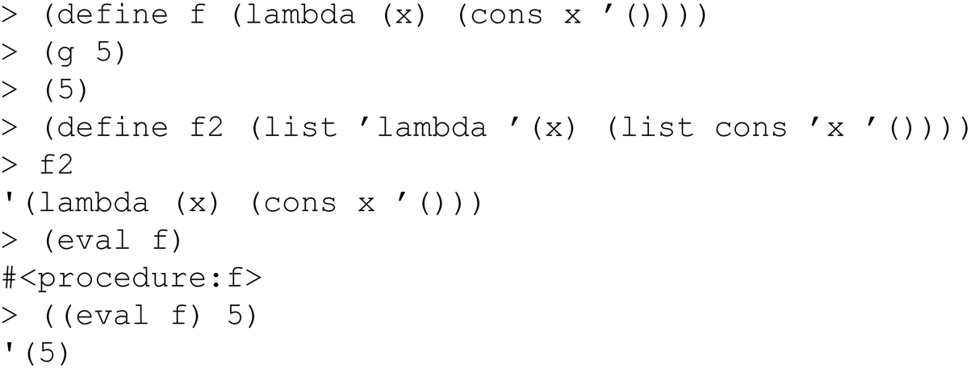
eval / apply in Scheme
eval and apply are the heart of any interpreter.
eval is the Scheme primitive analog of evaluate_expr function in our coming Camille interpreter.
eval accepts an expression and an environment as arguments.

Slide 44
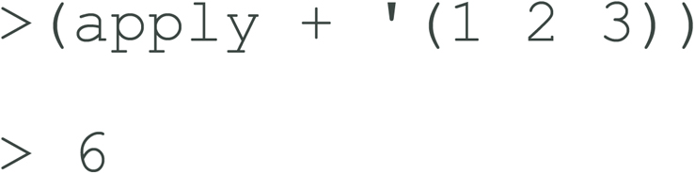
apply in Scheme
apply is the Scheme primitive analog of the family of apply_* functions in our coming Camille interpreter (e.g., apply_primitive, apply_closure, and so on).
apply accepts a function and its arguments as arguments:

Slide 45
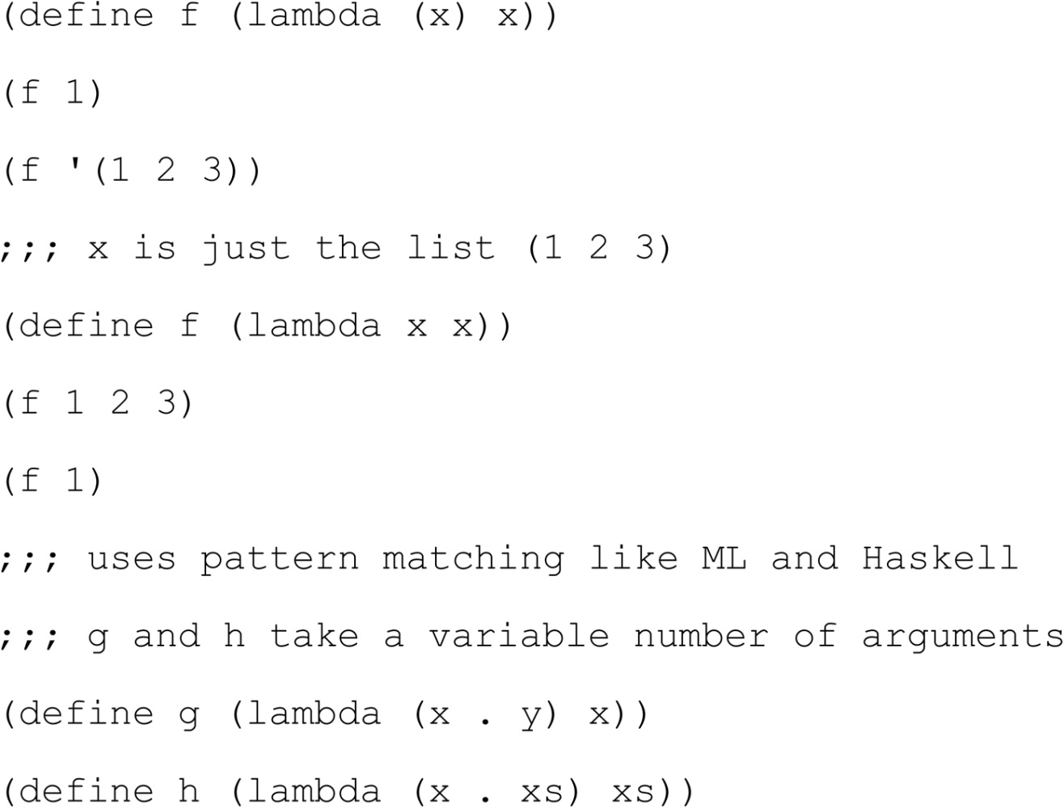
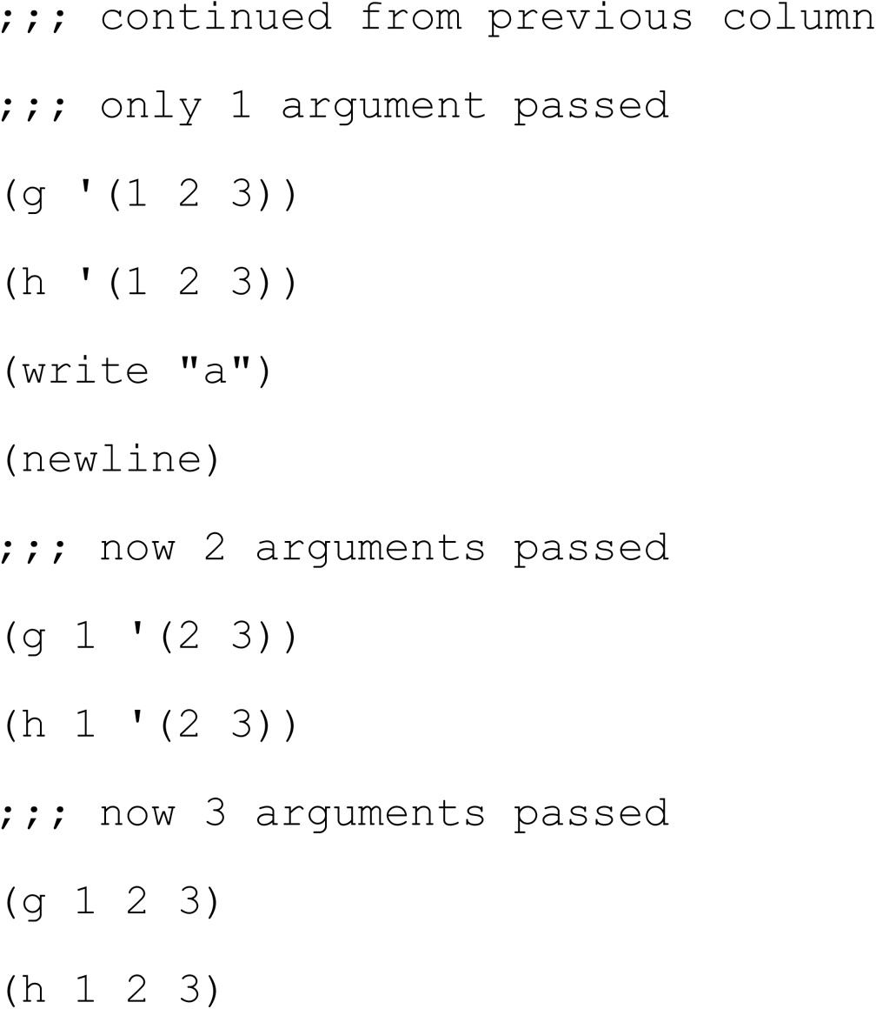
7.10 Variable-Length Argument Lists in Scheme (2 of 2)

Slide 46
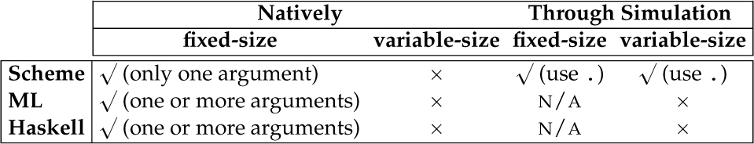
Table 7.4 Scheme Vis-à-Vis ML and Haskell for Fixed- and Variable-Sized Argument Lists

Slide 47
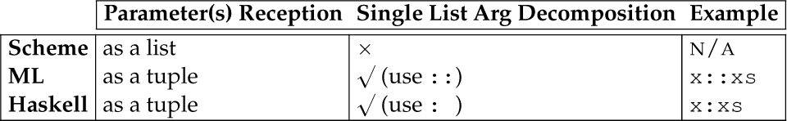
Table 7.5 Scheme Vis-à-Vis ML and Haskell for Reception and Decomposition of Argument(s)

Slide 48
Outline
7.1 Chapter Objectives
7.2 Introduction
7.3 Type Checking
7.4 Type Conversion, Coercion, and Casting
7.5 Parametric Polymorphism
7.6 Operator/Function Overloading
7.7 Function Overriding
7.8 Static/Dynamic Typing Vis-à-Vis Explicit/Implicit Typing
7.9 Type Inference
7.10 Variable-Length Argument Lists in Scheme
7.11 Thematic Takeaways

Slide 49
7.11 Thematic Takeaways
Languages using static type checking detect nearly all type errors before run-time; languages using dynamic type checking delay the detection of most type errors until run-time.
The use of automatic type inference allows a statically typed language to achieve reliability and safety without the burden of having to declare the type of every value or variable:
There are practical trade-offs between statically and dynamically typed languages—such as other issues in the design and use of programming languages.

Slide 50
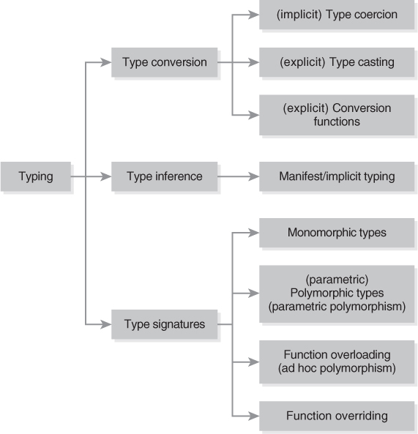
Figure 7.1 Hierarchy of Concepts to Which the Study of Typing Leads

